Slide 1

WELCOME
Date: 05/06/2018
1st Project Defense on
Welcome
EClient
(A perfect Client Management Tool(CMT))
By:
Oscar Garbuja : 2015-1-53-0122
Prabhu Gurung : 2015-1-53-0124
Pradeep Poudel : 2015-1-53-0125
Pradip Dhakal : 2015-1-53-0126

Slide 2
What was the IDEA ?
Requirement gathering Tool.
- Gather client functional/non-functional/design requirements.
Client Management Tool.
- Visualize ongoing project with progress on bars/circle/chart.
Project Tracking Tool.
- Track project with module base/functional base timing
Idea
Welcome
1

Slide 3
Where this project came from ?
Idea
Welcome
2

Slide 4
WHERE to implement ?
For college project (By student and By teacher)
- By teachers: assign tasks to students and track their progress.
- By student: easily done tasks with steps(simply checked steps).
For client project (software/app/web app)
- Real time rendering design
- Further track working procedure
While doing remote (team) project
- Team can easily done tasks from different geographical location.
On hourly based work/Bi-weekly based work
- Track time / count total time / module base time.
Implement
Welcome
3

Slide 5
TEAM and Project Distribution
NAME | MAIN ROLE | SUB ROLE
Oscar Garbuja (http://eversoftgroup.com) | Testing | Documentation
Prabhu Gurung (http://eversoftgroup.com) | Designing | Testing
Pradeep Poudel (http://pradeeppoudel.com.np) | Documentation | Coding
Pradip Dhakal (http://dhakalpradip.com.np) | Coding | Design/Testing
Proj. Distribution
Welcome
4

Slide 6
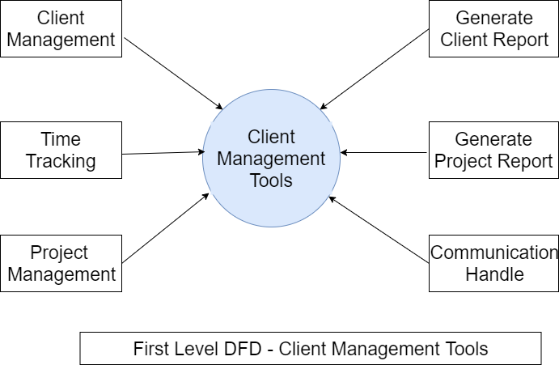
Data Flow Diagram (DFD)
DFD
Welcome
5

Slide 7
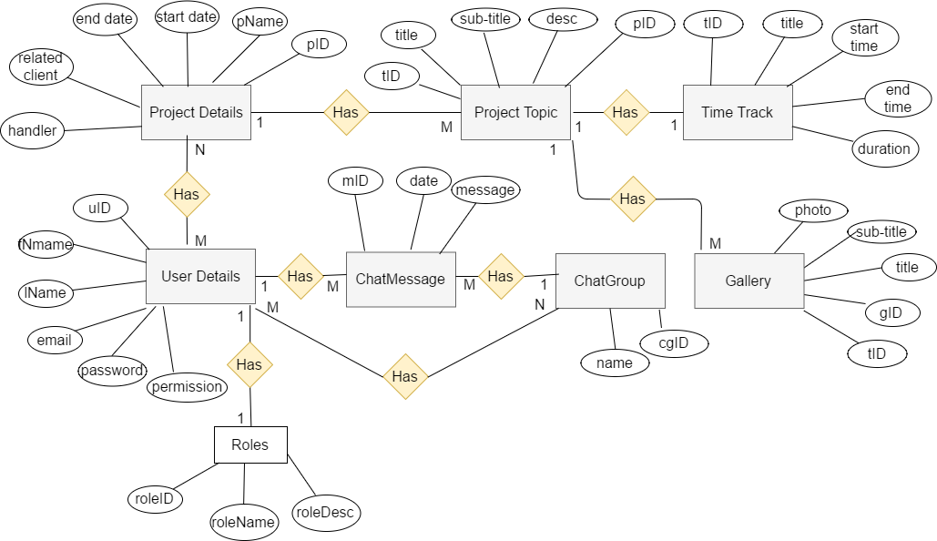
Entity Relationship-Diagram (ER-Diagram)
ER-Diagram
Welcome
6

Slide 8
What we will use ?
1. Back-end:
- Mysql for database.
- PHP for server side.
2. Front-End:
-HTML/CSS/JS for front end.
-Materialize CSS framework.
3. Design Tools:
-Adobe XD
-Adobe Photoshop/Indesign.
-Hand drawing.
-Flowchart/DFD maker.
4. Documentation:
- Microsoft Word.
- Microsoft Powerpoint.
5. Testing:
-PHPUnit
Uses
Welcome
7

Slide 9
Project Objectives / Features
Specialize on Web Application & Software for now.
Able to design / Interface / Wireframe of Project.
Features to collaborate with client
Progress and status of project.
To Communicate between client and team members.
Backup (Automatic / Manual Backup)
Responsive Layout
& many more…….
Objective
Welcome
8

Slide 10
Project Time Period
Duration
10 Days
7 Days
23 Days
10 Days
10 Days
Feasibility Study
Wireframe / Interface
System Development
System Testing
Implementation
9

Slide 11
Delivarable
Atomic requirements i.e. functional and non-functional requirements.
Easy information and resource gathering from client
Real time project development tracking by client
Effective communication with client and development team
Instant prototyping and product template creation
6. Efficient time consumption
Delivarable
10

Slide 12
Thank You
For your Attendance
Thank you
10 Days
ANY QUESTIONS ?
Feasibility Study

